Slide 1
Sales & Cash Register / Admin Part 1 & Admin Tools

Slide 2
Agenda
Manager Daily Workflow Overview
Item Updates
Help Portal
Creating New Users
Shift Acceptance
Creating Support Tickets

Slide 3
Manager Daily Workflow Overview
To complete daily paperwork, the store manager needs to walk through several steps in CStoreOffice® every day. To help the manager perform his or her routine activities, CStoreOffice® offers the Manager Daily Workflow
To access the Manager Daily Workflow from the CStoreOffice® homepage :
Hover over Workflows at the top right of the screen
Select Manager Daily Workflow

Slide 4
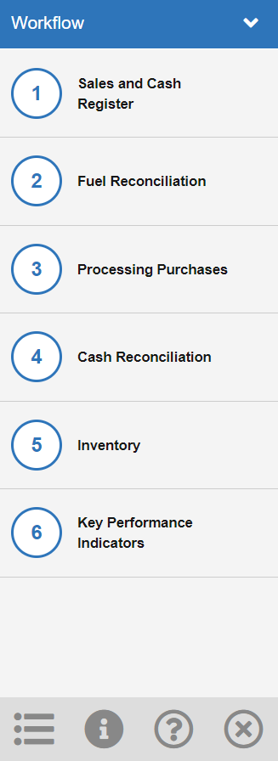
Manager Daily Workflow Overview
Six steps within the workflow:
Sales and Cash Register
Fuel Reconciliation
Processing Purchases
Cash Reconciliation
Inventory
Key Performance Indicators (KPIs)

Slide 5
Manager Daily Workflow Overview
Workflow Navigation
Click the dropdown arrow to minimize/maximize the workflow

Slide 6
Manager Daily Workflow Overview
Workflow Navigation
Click the Station switcher to switch between station locations
NOTE: You will not have access to this icon if you only have 1 station

Slide 7
Manager Daily Workflow Overview
Workflow Navigation
Click the Instruction icon to turn on instructions that will pop up throughout the workflow

Slide 8
Manager Daily Workflow Overview
Workflow Navigation
Click the question icon to be taken to the Petrosoft help section

Slide 9
Manager Daily Workflow Overview
Workflow Navigation
Click the X Icon to exit the workflow

Slide 10
Manager Daily Workflow Overview
Workflow Navigation
Double Click the blue banner to switch to a horizontal view of the workflow
Click and drag the blue banner to move to a different location on the screen

Slide 11
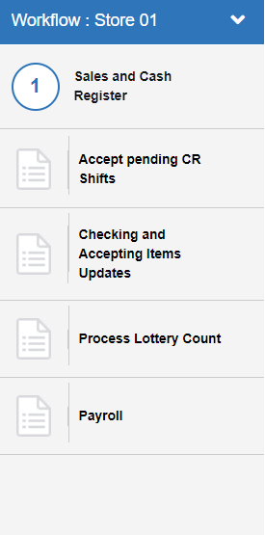
MDWF: Step 1 – Accept pending CR Shift
From the workflow screen:
Click on Step 1
Click Accept pending CR Shifts

Slide 12
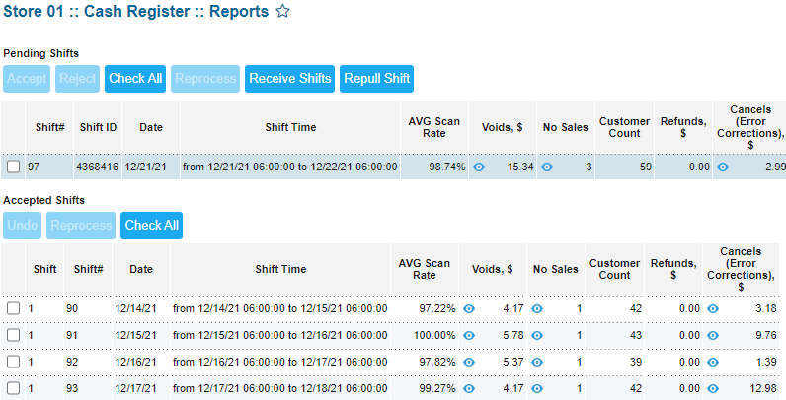
MDWF: Step 1 – Accept pending CR Shift
Pending Shifts – Shows any pending shifts that have not yet been accepted into CStoreOffice®
NOTE: If your account is on Auto-accept, your shifts will not show in this section
Accepted Shifts – Shifts that have been accepted into CStoreOffice®
NOTE: It is suggested to print a register shift report (or daily close report) and compare with data in CStoreOffice®, for accuracy

Slide 13
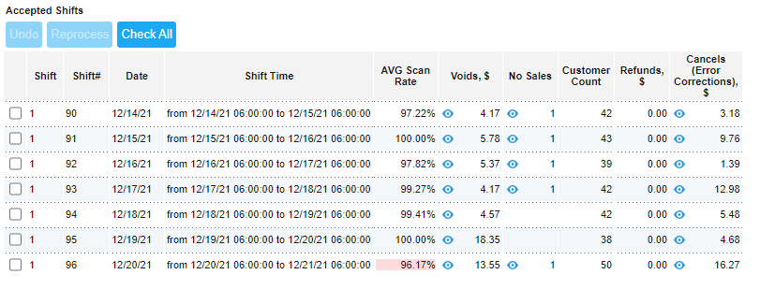
MDWF: Step 1 – Accept pending CR Shift
Shift – Which shift came in to CStoreOffice®
NOTE: If pulling in full day reports, shift will always show as 1
Shift# - Number of shifts in CStoreOffice®
Date – Date of shift
Shift Time – Timeframe of shift
AVG Scan Rate – Rate of items that have been scanned or PLU used
Voids – Total dollar amount of voided items
No Sale – Number of no Sales that shift
Customer count – number of customers that shift
Refunds – Total dollar amount of refunds that shift
Cancels – Total number of cancels/error corrections that shift

Slide 14
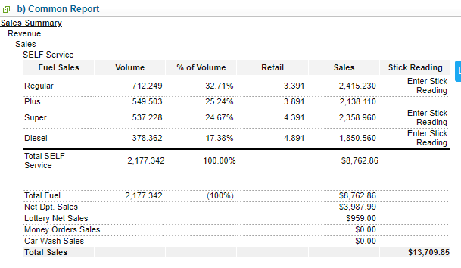
MDWF: Step 1 – Accept pending CR Shift
Sales Summary - Sales
Fuel Sales – Breakdown of volume, % of volume, Retail, and sales of each grade of fuel sold
Total Fuel – Total dollar amount of fuel sold
Net Dept Sales – Dept sales, less any dept refunds
Lottery Net Sales – Online and instant sales, less any payouts
Money Order Sales – Total of Money order sales, if any
Car Wash Sales – Sales form Car Wash, if connected to register
Total sales – Fuel, lottery Net, Money Order, and Car wash sales

Slide 15
MDWF: Step 1 – Accept pending CR Shift
Sales Summary – Other Revenue
Taxable Sales – Total dollar amount of sales that are being taxed
Taxes Collected – total dollar amount of taxes collected
Total other revenue – Total of taxes collected
Total revenue – Total sales + Total other revenue

Slide 16
MDWF: Step 1 – Accept pending CR Shift
Sales Summary – Expenses
Paid Out – Any expenses paid out in cash from the register (Excluding lottery)
Fuel Adjustment – Dollar amount of pump tests
Total Expenses – Paid Out + Fuel Adjustment
Paid In – Any cash paid-in to the register, excluding sales
Total Money Due – Total Revenue, less the Total Expenses

Slide 17
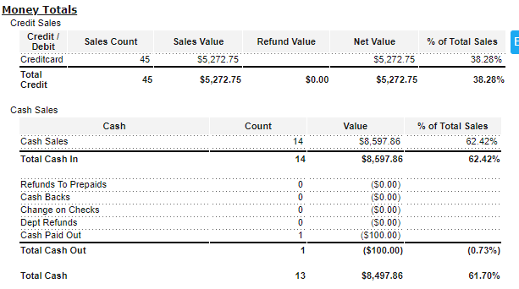
MDWF: Step 1 – Accept pending CR Shift
Money Totals
Credit Sales – Breakdown of cred & debit card sales
Cash sales – Breakdown of cash sales
Refunds to prepaids – refunds given based on pre-paid cash for fuel
Cash Back – Cash back on debit cards
Change On Checks – Cash back on checks
Dept refunds – Refunds on department sales
Cash paid out – Expenses paid out in cash (excluding lottery)
Total Cash Out – Refunds to prepaids, Cash back, Change on Checks, dept refunds, and cash paid out
Total Cash – Total cash in, less total cash out

Slide 18
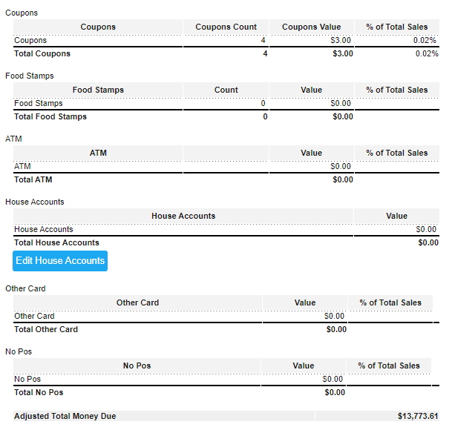
MDWF: Step 1 – Accept pending CR Shift
Money Totals
Coupons – Total of coupons accepted
Food Stamps – Total amount of food stamps accepted
ATM – Total cash put into register
NOTE: This will only populate if the ATM is filled directly from the register
House Accounts – List of any house account charges
Other Card – Generally not used
No POS – Generally not used
Adjusted Total Money Due – Should match total money due in top section

Slide 19
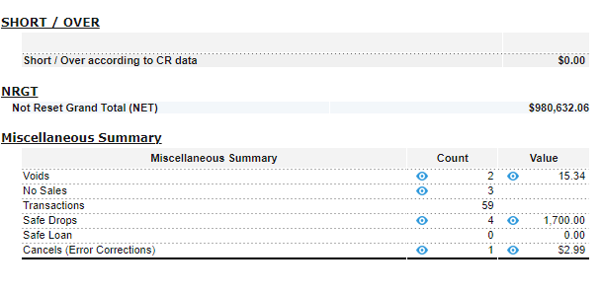
MDWF: Step 1 – Accept pending CR Shift
Short/Over – Short/Over based on cash register Data
NOTE: This should be zero, indicating that CStoreOffice® has pulled in all data from the register. This is NOT your cash over/short
NRGT – (Non-Resettable Grand Total) – Total sales run through the register. This number should increase each day.
Miscellaneous Summary – Summary of other register actions

Slide 20
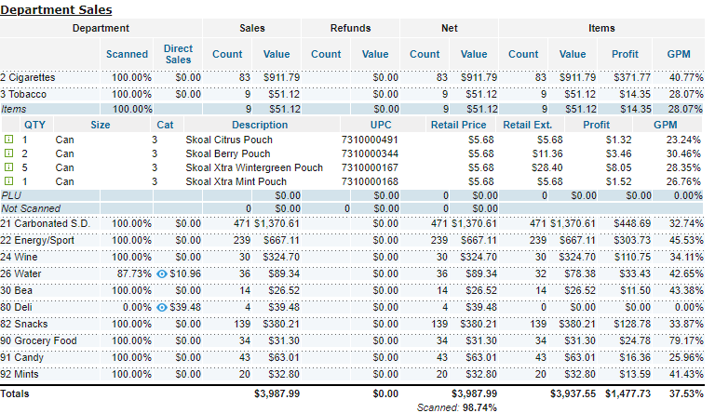
MDWF: Step 1 – Accept pending CR Shift
Department sales – Breakdown of sales, based on department
Clicking on each department will expand to reveal how items were sold (Scanned, PLU, or direct dept sale)
Clicking on Items or PLU will reveal itemized information about what was sold

Slide 21
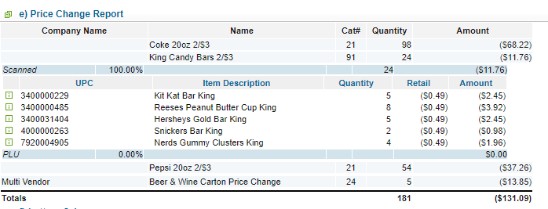
MDWF: Step 1 – Accept pending CR Shift
Price Change Report – Shows any manual price change or promotion applied at the register
Clicking Each promotion will open itemized information on what was included
NOTE: “Unknown Promotion” is a manual price change that is not listed as a promotion in CStoreOffice®

Slide 22
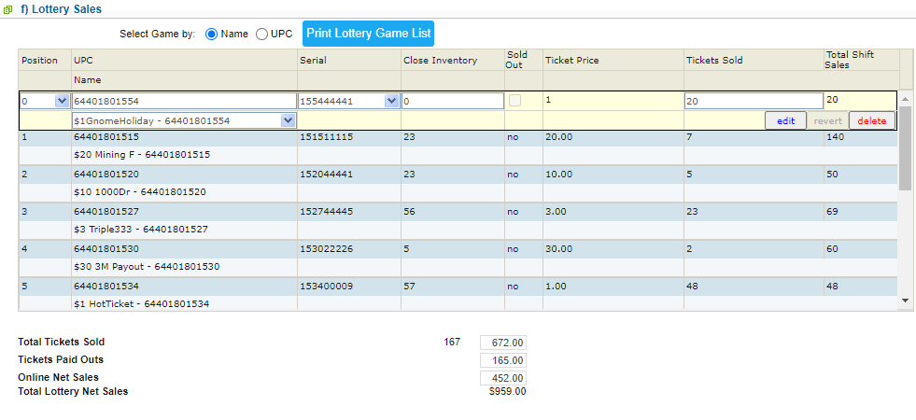
MDWF: Step 1 – Accept pending CR Shift
Lottery Sales – Details of lottery sales run through register
Instant tickets are listed by name & Serial number, if instant tickets have been added to the lottery section of CStoreOffice®
Total Tickets Sold – Total Instant Tickets sold
Tickets Paid Outs – Total lottery payouts
Online Net Sale – Online Ticket sales
Total Lottery New Sales – Online + instant sales, less lotter payouts

Slide 23
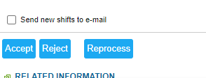
MDWF: Step 1 – Accept pending CR Shift
To Accept pending shift after reviewing data:
Click Accept at the bottom of the page
NOTE: You will not have this option if your account is on Auto-Accept

Slide 24
MDWF: Step 1 – Checking and Accepting Items Updates
From the workflow screen:
Click on Step 1
Click Checking and Accepting Items Updates

Slide 25
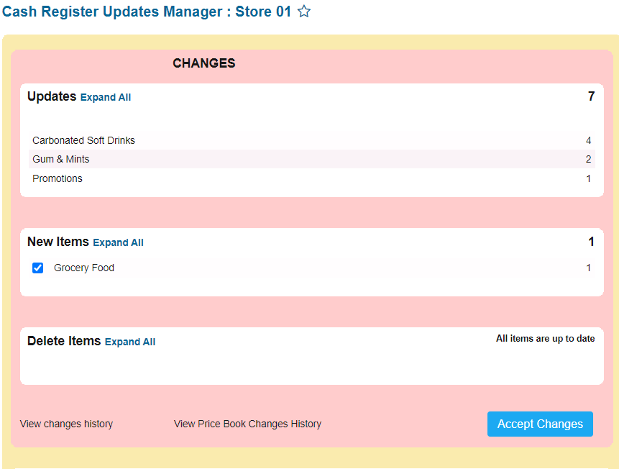
MDWF: Step 1 – Checking and Accepting Items Updates
Updates – List of updated items and promotions
New Items – List of newly added items
Delete Items – List of items deleted from CStoreOffice®

Slide 26
MDWF: Step 1 – Checking and Accepting Items Updates
Clicking Expand All in each section will show the details of the item updates being made

Slide 27
MDWF: Step 1 – Checking and Accepting Items Updates
This line shows the Category of the item being updated

Slide 28
MDWF: Step 1 – Checking and Accepting Items Updates
This line shows the Price group of the item being updated
NOTE: If the item is not part of a price group, this line will show “Undefined”

Slide 29
MDWF: Step 1 – Checking and Accepting Items Updates
This line shows the Promo Group of the item being updated
NOTE: If the item is not part of a promo group, this line will show “Undefined”

Slide 30
MDWF: Step 1 – Checking and Accepting Items Updates
This line shows the item details
Attributes shown in RED reflect the new update
In this example, Pepsi Classic 12oz Can has had a retail change from $0.99 to $0.89.

Slide 31
MDWF: Step 1 – Checking and Accepting Items Updates
If there are any errors with the item details, right click on the item line to open the Row Options
You can change the item’s retail, CR Department, Category, CR name, Price Group, and/or Promo Group by clicking the corresponding option
You can also click “Item setup” to be taken to the item setup screen in CStoreOffice®

Slide 32
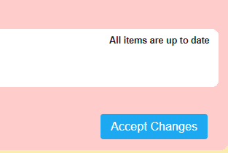
MDWF: Step 1 – Checking and Accepting Items Updates
Once you have reviewed all item updates in each section, and confirmed that they are accurate, Scroll down to click Accept Changes

Slide 33
MDWF: Step 1 – Checking and Accepting Items Updates
If you accepted any retail price changes, you will receive the following pop-up notification

Slide 34
MDWF: Step 1 – Checking and Accepting Items Updates
Read through the steps and click Done

Slide 35
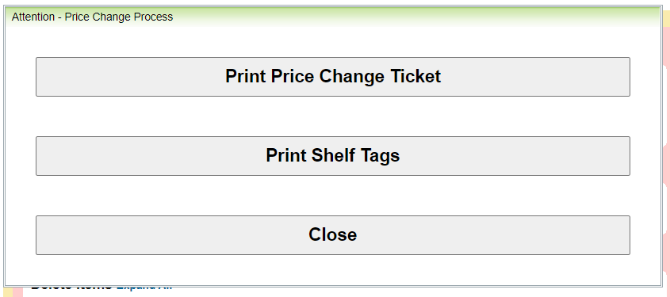
MDWF: Step 1 – Checking and Accepting Items Updates
After a few moments, you will receive this pop-up notification
Click Print Price Change Ticket

Slide 36
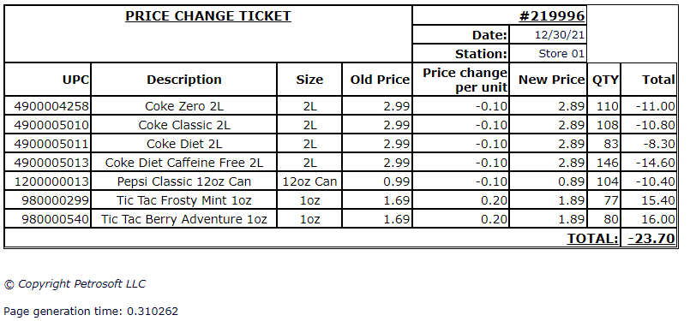
MDWF: Step 1 – Checking and Accepting Items Updates
You will be prompted to print a price change ticket for each of the items whose retails updates were accepted
Someone should go to the store and count each of these items, noting the count on the printed price change ticket

Slide 37
MDWF: Step 1 – Checking and Accepting Items Updates
Click Print Shelf Tags if you are using CStoreOffice® Shelf tags

Slide 38
MDWF: Step 1 – Checking and Accepting Items Updates
Once you have printed a price change ticket and shelf tags, if applicable, click Close to exit the window.

Slide 39
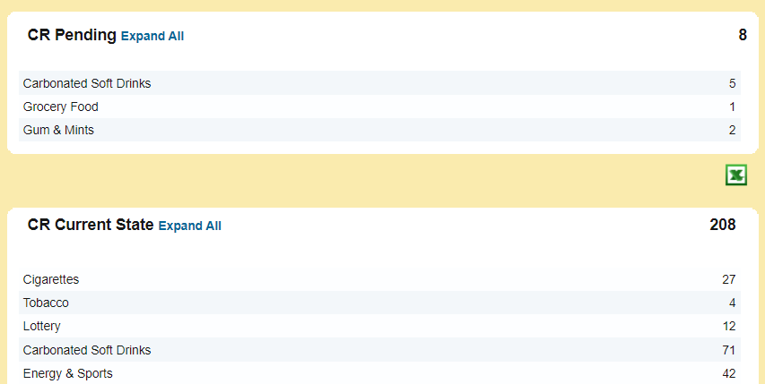
MDWF: Step 1 – Checking and Accepting Items Updates
CR Pending – Item updates that have been accepted, but have not been pushed to your register yet
NOTE: You may have to end a shift in order to pull recent updates into your register
CR Current State – Items that have already been pushed to your register from CStoreOffice®

Slide 40
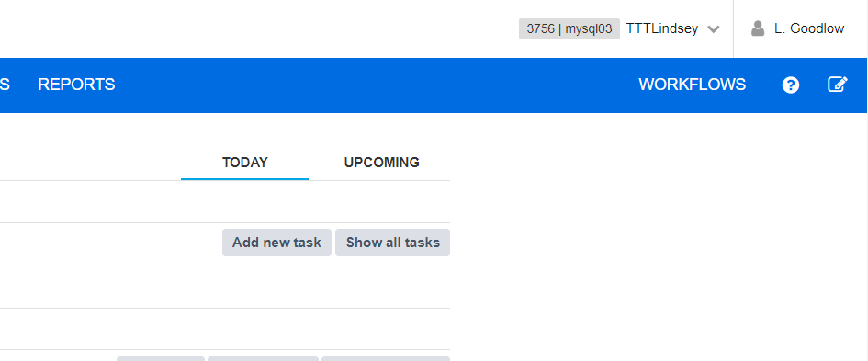
Creating New Users
To create a new user, from the CStoreOffice® Homepage:
Click on your name in the top right corner

Slide 41
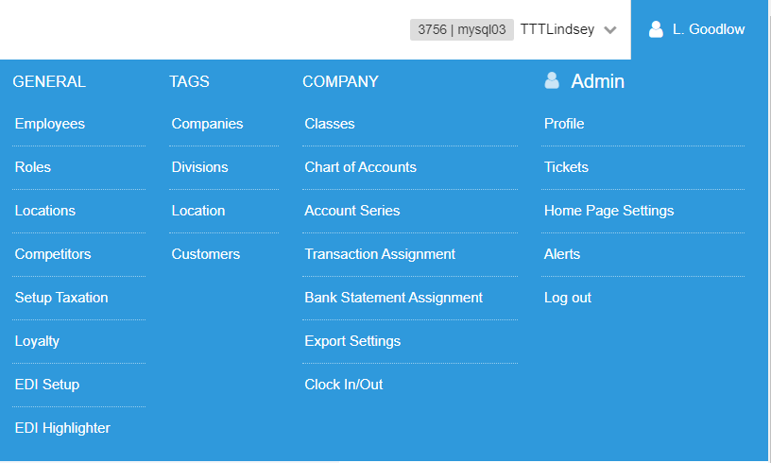
Creating New Users
Click Employees

Slide 42
Creating New Users
The employee list will be displayed
Click New

Slide 43
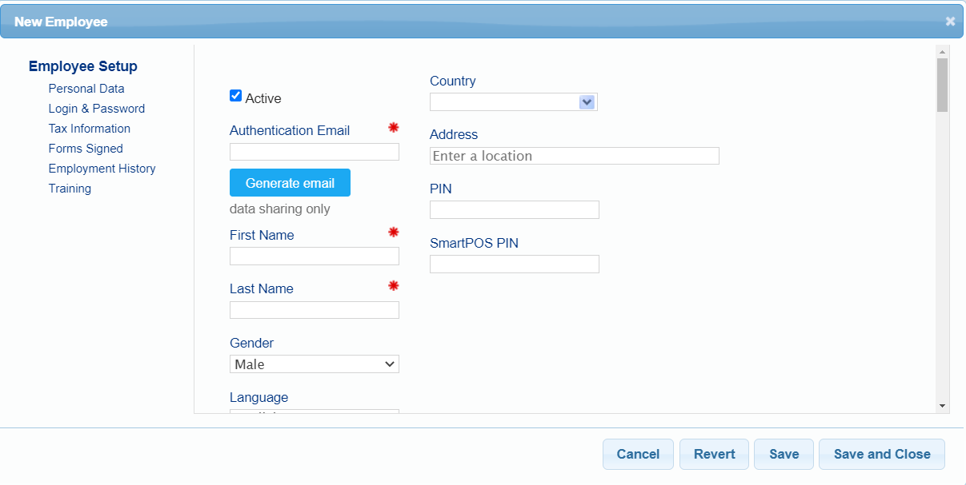
Creating New Users
The Employee Setup screen will display
Complete the following required fields:
Authentication Email – Real email address that employee has access to. This cannot be the same as any other email on file.
First Name
Last Name

Slide 44
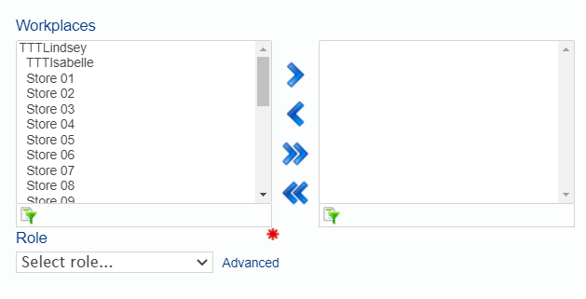
Creating New Users
Scroll down to the “workplaces” Section
Select store locations that this employee needs access to and move them to the right-side box using the center arrows

Slide 45
Creating New Users
Select the employee’s role:
Click the dropdown arrow next to “Select Role…”
Click the relevant role on the list
NOTE: All roles of Supervisor and above will have access to make changes to the Pricebook

Slide 46
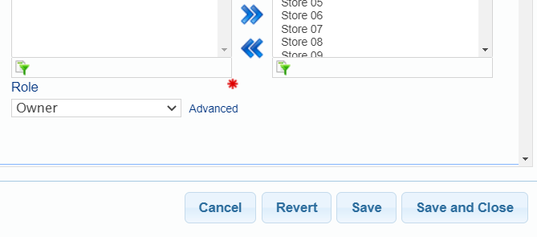
Creating New Users
Save – Saves the information entered
Save and Close – Saves the information entered and closes the window
NOTE: both options will prompt an email to be sent to the employee with instructions to set up their account password

Slide 47
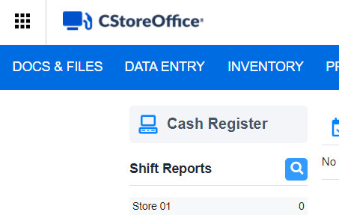
Help Portal
To access the Help Portal from the CStoreOffice® Homepage:
Click on the grid in the upper righthand corner

Slide 48
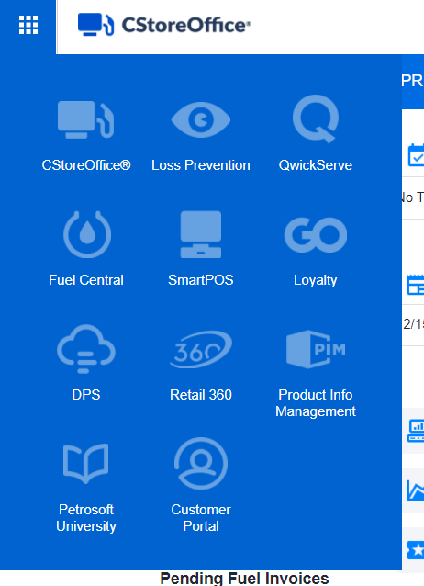
Help Portal
Select Petrosoft University

Slide 49
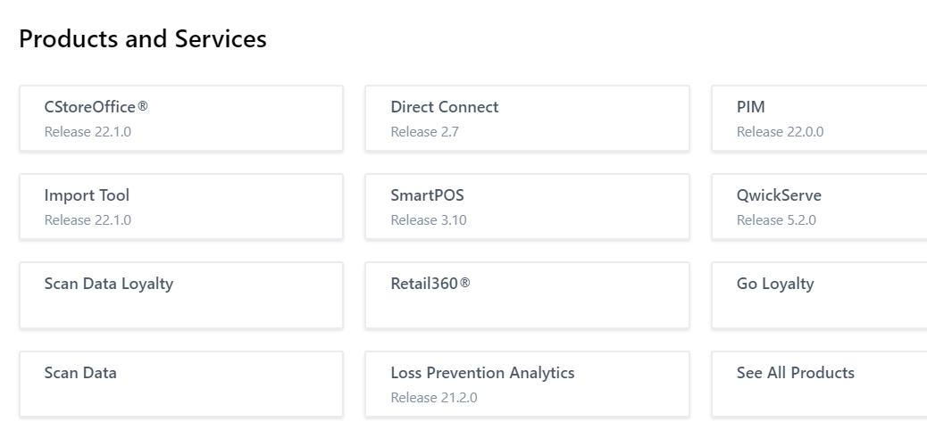
Help Portal
Select CStoreOffice® form the products and services list

Slide 50
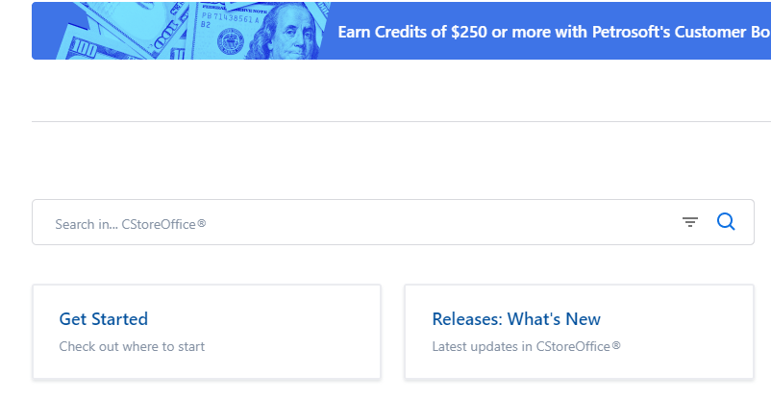
Help Portal
In the search bar, type key words to search for a relevant help topic

Slide 51
Help Portal
An alternate way to access the Help Protal:
Click the Question Mark icon beneath your name in the top righthand corner
NOTE: For most pages in CStoreOffice®, clicking this icon will take you directly to the Help Topic associated with that page

Slide 52
Creating Support Tickets
To create a support ticket:
Click the Square Icon beneath your name in the top righthand corner

Slide 53
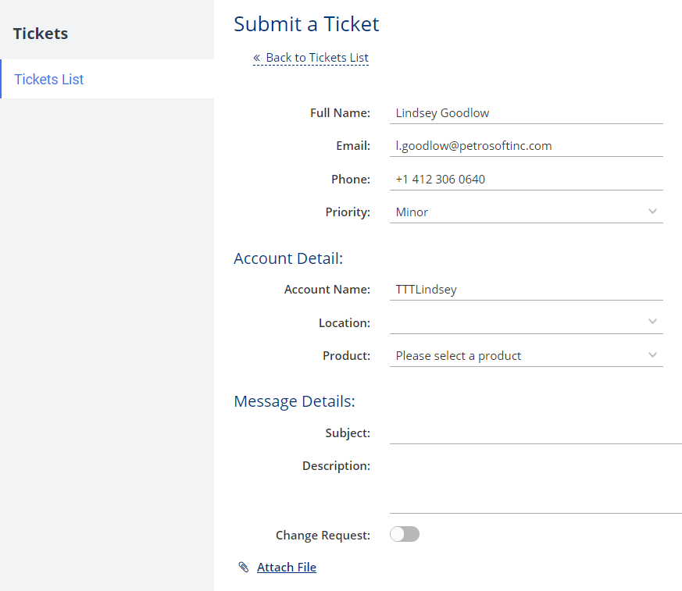
Creating Support Tickets
Ensure the following fields are complete:
Full Name – Should Auto-populate based on your name in CStoreOffice®
Email - Should Auto-populate based on your email address in CStoreOffice®
Phone – Will auto-populate if your phone number is listed in CStoreOffice®. If missing, please add a contact phone number

Slide 54
Creating Support Tickets
Select the priority of your support issue:
Click the dropdown arrow next to priority
Click the priority level for your issue
NOTE: Please be realistic with your priority level. High priority level is suggested for problems that are preventing you from operating your business

Slide 55
Creating Support Tickets
Complete the following fields:
Account Name – Should auto-populate based on your CStoreOffice® account name
Location – Choose the store location that is affected by the issue from the dropdown list. If all locations are affected, leave this field blank
Product – Click the dropdown arrow and select the relevant product from the product list

Slide 56
Creating Support Tickets
Complete the following fields:
Subject – A few word regarding the subject of your issue
Description – As much detail as possible regarding the issue you are experiencing. Be as specific as possible.
Attach File – If you have a photo or screenshot of the issue or error you are experiencing, attach the file by clicking here.

Slide 57
Creating Support Tickets
Once complete, scroll up and click Submit

Slide 58
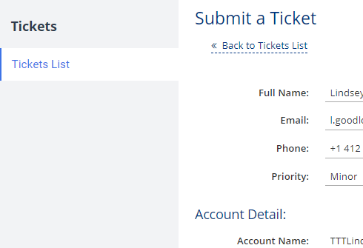
Creating Support Tickets
To access a list of previously submitted tickets:
Click Tickets List

Slide 59
Conclusion
Notes:
Say: Thank you for your time. Does anyone have any questions?
Do: Respond to questions.
Do: <End Meeting>

